Slide 1
INDIAN CRIME
DATA ANALYSIS
Uncovering Crime Patterns Across India | 2020–2024

Slide 2
PROBLEM STATEMENT
What is India's Crime Reality?
Key Questions:
Which State is unsafe
Which crimes are growing faster
What we can do to stop crime

Slide 3
Dataset Overview
About the Data
Source :- Kaggle
Total Records -40k+
Crime Type -10+
Years :- 2020-2024

Slide 4
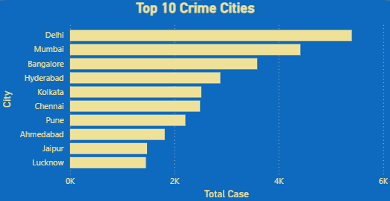
Key Findings
Top 10 Cities by Crime
Delhi is the city with most of the the crimes while Mumbai and Banglore is in 2nd and 3rd Positions
3 cities Alone record to 50% of Crime

Slide 5
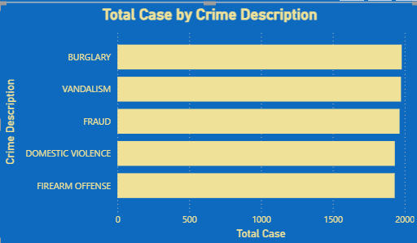
Top 5 Crime Happening Around
Burgulary is the top most crime while vandalism in second
Top 5 crimes Equally Distributed suggesting no crime is dominated

Slide 6
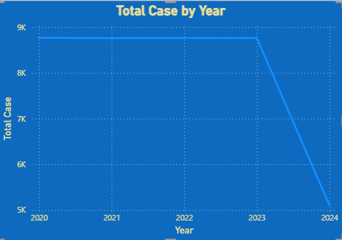
Crime Year wise
Total cases remained stable at 8.5k+ annually from 2020–2023. The sharp drop in 2024 to 5k+ cases is likely due to incomplete data for that year rather than an actual reduction in crime.

Slide 7
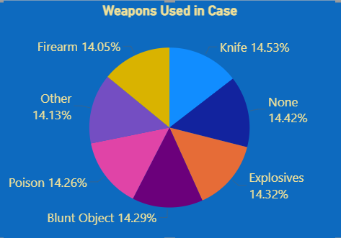
Which Weapon IS used Most
Knife (14.53%), None (14.42%), Explosives (14.32%), Blunt Object (14.29%), Poison (14.26%), Other (14.13%), and Firearm (14.05%) — with less than 0.5% difference between them

Slide 8
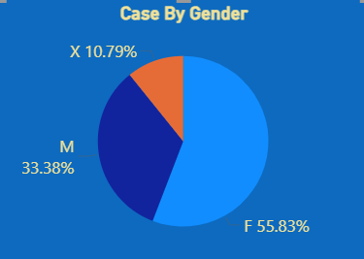
Crimes by Victims Gender
The victims of Crimes are mostly Females (56%) ,while Men with (33%) and X(11%)

Slide 9
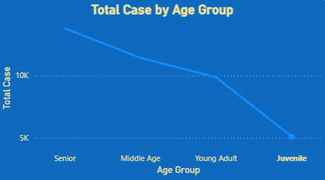
Crime By Victim Age
Highest Crime victims Are the Senior Citizens
While Juvinile Is lowest one
Data Showing Higher the age high chance of victim Pattern

Slide 10
RECOMMENDATIONS
Law enforcement agencies should prioritize additional police personnel, surveillance infrastructure, and rapid response units in cities like (Delhi ,Mumbai , Banglore etc …)
Senior citizens show the highest crime involvement . Dedicated helplines, community patrol programs, and awareness campaigns should be launched specifically targeting elderly safety
Banks, financial institutions and citizens need stronger digital literacy programs and fraud detection systems to combat financial crimes
With Knives and Firearms among top weapons used, stricter weapon monitoring Should done ,online sales knives should be banned
Crimes against women remain a critical concern , requiring immediate attention from law enforcement and policy makers
Domestic Violence consistently ranks among the top 5 crime types, highlighting the urgent need for stronger implementation of women protection laws and support systems

